Slide 1




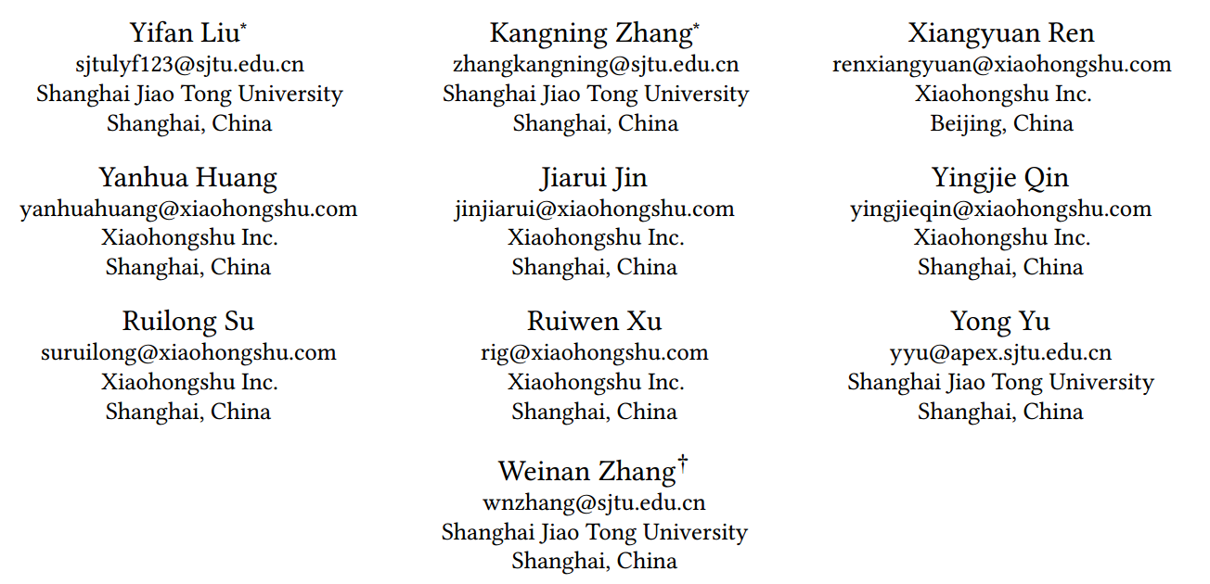





ATAI
Advanced Techniqueof Artificial Intelligence
ATAI
ChongqingUniversity _{AdvancedTechniqueof}
of Technology Artificial Intelligence
Chongqing University of
Technology
Chongqing University ^{ATAI}
_{of Technology} Advanced Techniqueof
Artificial Intelligence
Chongqing University of Technology
Chongqing University of Technology
AlignRec: Aligning and Training in Multimodal Recommendations
code:https:https://github.com/sjtulyf123/AlignRec_CIKM24
—— CIKM 2024
Reported by ZhenDong Huang
1

Slide 2

ATAI
AdvancedTechniqueof
Artificial Intelligence
ATAI
ChongqingUniversity _{AdvancedTechniqueof}
of Technology Artificial Intelligence
ChongqingUniversity of Technology
Motivation
1.How to perform alignment in multimodal recommendation has not been carefully designed.
2.The popular end-to-end training with joint optimization on alignment and recommendation tasks is hard to learn well.
3.The influence of content modality to multimodal recommendation has not been fully studied.

Slide 3

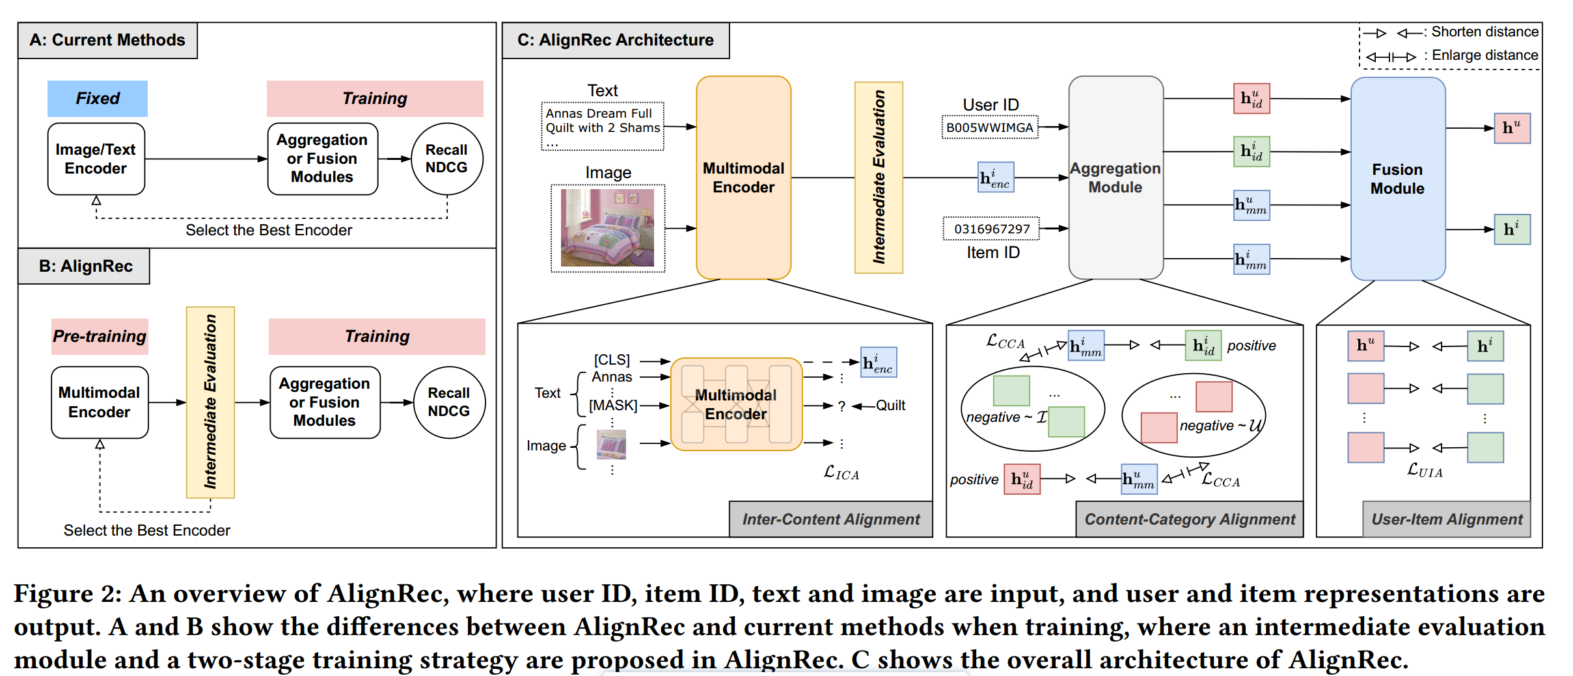
ChongqingUniversity of Technology
ATAI
AdvancedTechniqueof
Artificial Intelligence
ATAI
ChongqingUniversity _{AdvancedTechniqueof}
of Technology Artificial Intelligence
Overview

Slide 4



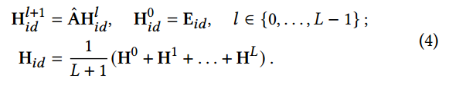
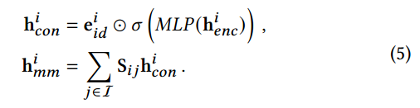
ChongqingUniversity of Technology
ATAI
AdvancedTechniqueof
Artificial Intelligence
ATAI
ChongqingUniversity _{AdvancedTechniqueof}
of Technology Artificial Intelligence
Method

Slide 5




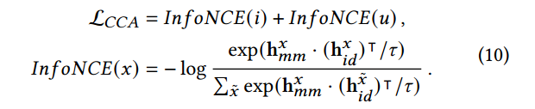
ChongqingUniversity of Technology
ATAI
AdvancedTechniqueof
Artificial Intelligence
ATAI
ChongqingUniversity _{AdvancedTechniqueof}
of Technology Artificial Intelligence
Method

Slide 6



ChongqingUniversity of Technology
ATAI
AdvancedTechniqueof
Artificial Intelligence
ATAI
ChongqingUniversity _{AdvancedTechniqueof}
of Technology Artificial Intelligence
Method

Slide 7

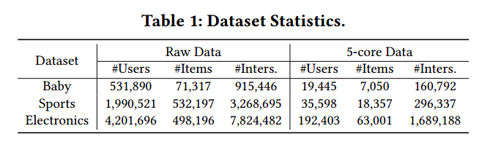
ATAI
AdvancedTechniqueof
Artificial Intelligence
ATAI
ChongqingUniversity _{AdvancedTechniqueof}
of Technology Artificial Intelligence
ChongqingUniversity of Technology
Experiments

Slide 8
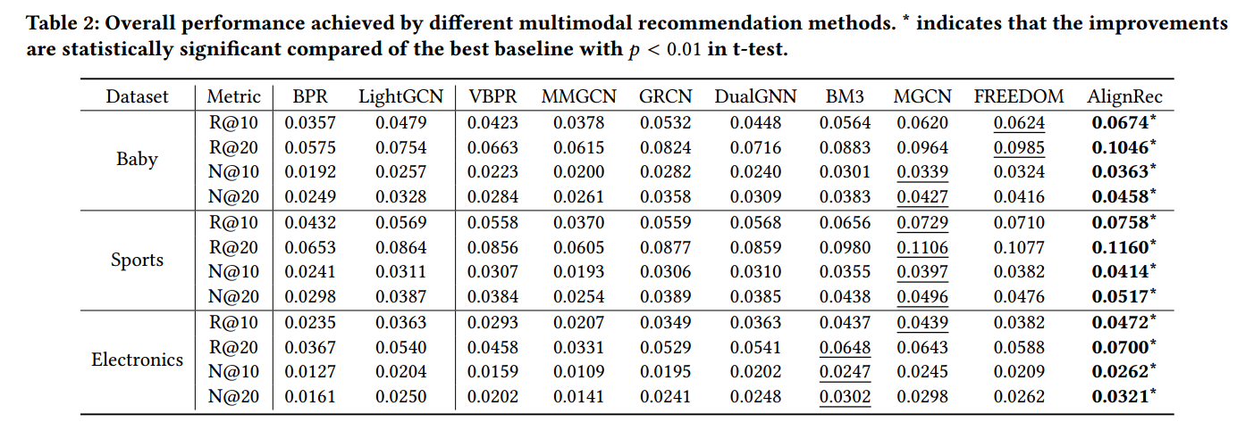
ATAI
AdvancedTechniqueof
Artificial Intelligence
ATAI
ChongqingUniversity _{AdvancedTechniqueof}
of Technology Artificial Intelligence
ChongqingUniversity of Technology
Experiments

Slide 9
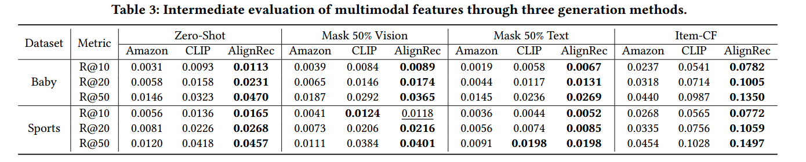
ATAI
AdvancedTechniqueof
Artificial Intelligence
ATAI
ChongqingUniversity _{AdvancedTechniqueof}
of Technology Artificial Intelligence
ChongqingUniversity of Technology
Experiments

Slide 10
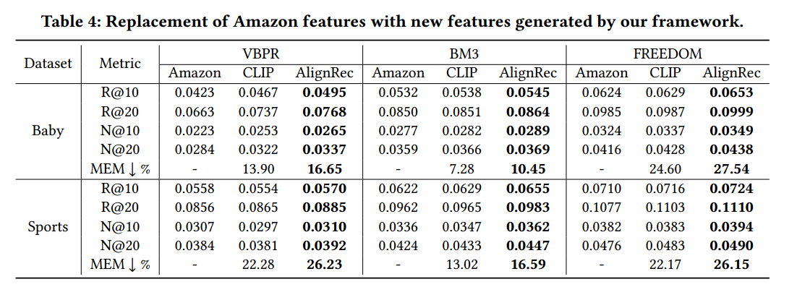
ATAI
AdvancedTechniqueof
Artificial Intelligence
ATAI
ChongqingUniversity _{AdvancedTechniqueof}
of Technology Artificial Intelligence
ChongqingUniversity of Technology
Experiments

Slide 11
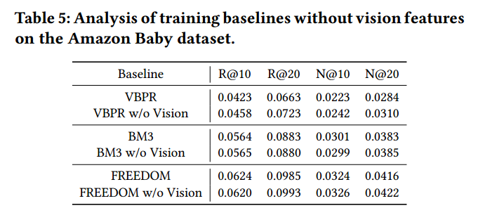
ATAI
AdvancedTechniqueof
Artificial Intelligence
ATAI
ChongqingUniversity _{AdvancedTechniqueof}
of Technology Artificial Intelligence
ChongqingUniversity of Technology
Experiments

Slide 12
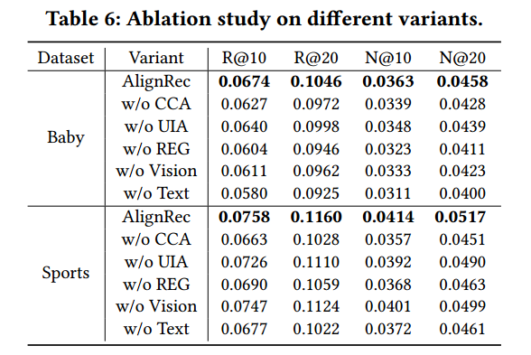
ATAI
AdvancedTechniqueof
Artificial Intelligence
ATAI
ChongqingUniversity _{AdvancedTechniqueof}
of Technology Artificial Intelligence
ChongqingUniversity of Technology
Experiments

Slide 13
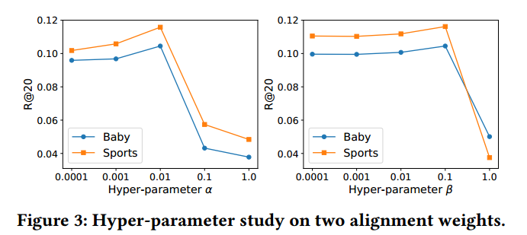
ATAI
AdvancedTechniqueof
Artificial Intelligence
ATAI
ChongqingUniversity _{AdvancedTechniqueof}
of Technology Artificial Intelligence
ChongqingUniversity of Technology
Experiments

Slide 14
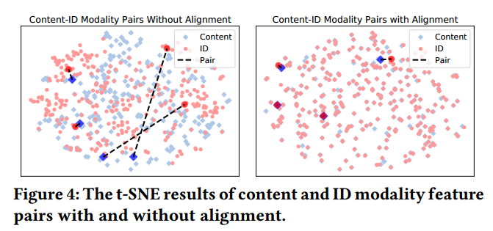
ATAI
AdvancedTechniqueof
Artificial Intelligence
ATAI
ChongqingUniversity _{AdvancedTechniqueof}
of Technology Artificial Intelligence
ChongqingUniversity of Technology
Experiments

Slide 15
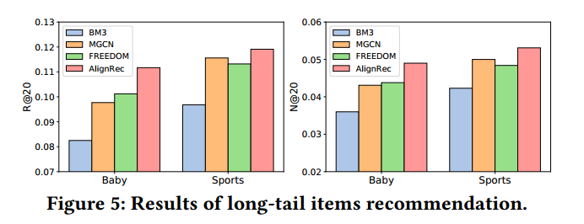
ATAI
AdvancedTechniqueof
Artificial Intelligence
ATAI
ChongqingUniversity _{AdvancedTechniqueof}
of Technology Artificial Intelligence
ChongqingUniversity of Technology
Experiments

Slide 16


ChongqingUniversity of Technology
ATAI
AdvancedTechniqueof
Artificial Intelligence
ATAI
ChongqingUniversity _{AdvancedTechniqueof}
of Technology Artificial Intelligence
Thanks!

